Slide 1
Software Systems Design and Integration
Lecture 9, Part I
Model-View-Controller Architecture

Slide 2
Content
1 MVC Design Pattern
  Example: Soccer League
3 Extended MVC in Java EE
  Dispatcher Pattern
  Business Delegate Pattern
  DAO Pattern
  Example: Student Information System
4 Java EE MVC Architectures and Tools

Slide 3
1 Model-View-Controller (MVC) Design Pattern
Idea: Separating the external presentation (view) from the internal representation (model) allows control of both the data and the operations
  MVC as a design pattern (MVC pattern) vs.
  MVC as a development framework (PHP JOOMLA, Java Spring) vs.
  MVC as a software architecture
History: Originally in Smalltalk for GUI; For Web apps first in one of Apache early projects (Tapestry) turned into Apache struts; Oracle Forms turned bc4j for use in Java
Design Patterns: Related to the Observer pattern

Slide 4
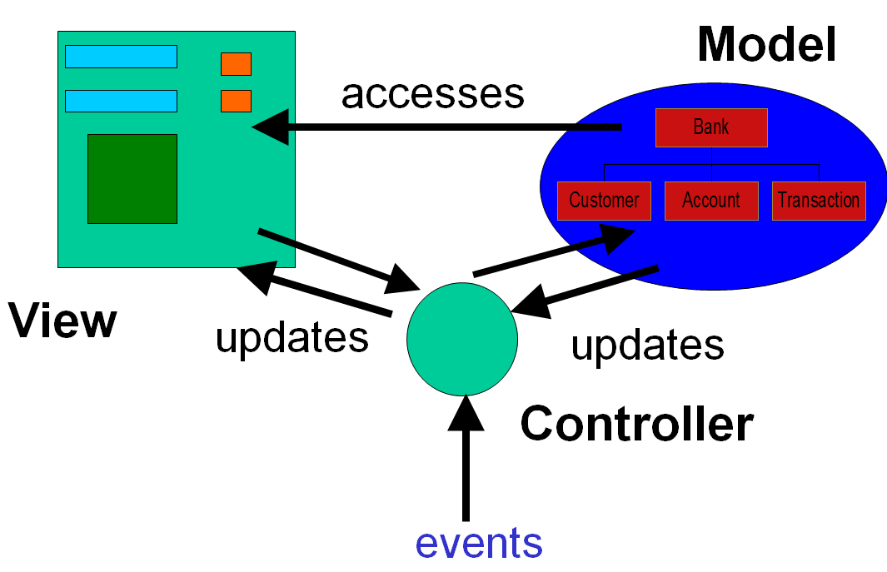
MVC – Architecture

Slide 5
MVC – Components
Model – domain data; represents real world knowledge, business data and data related operations
View – GUI; represents knowledge of the user and the input/output operations
Controller – event handler; reacts to external and internal events and synchronizes the model and the views when the data changes

Slide 6
MVC – Components Structure
«boundary»
View

viewData
notify changes
*
initialize()
1
notify()
outputData()
inputData()
«entity»

Model
1
modelData
dispatch events
update display
setOfObservers [1..*]

attachObserver()
1
detachObserver()
notifyObserver()
«control»
getData()
Controller
setData()

startup()
1
update data
*
updateView()
updateModel()

changeView()
retrieve data
changeModel()
Notes:
The operation update() in the AdvertView and AdvertController components triggers these components to request data from the CampaignModel component[1]. This model component has no knowledge of the way that each view and controller component will use its services. It need only know that all view and controller components must be informed whenever there is a change of state (a modification either of object attributes or of their links).
The attach() and detach() services in the CampaignModel component enable views and controllers to be added to the setOfObservers. This contains a list of all components that must be informed of any change to the model core data. In practice there would be separate views, each with its own controller, to support the requirements of the campaign manager and the director.
[1] In this example the CampaignModel will hold details of campaigns and their adverts.

Slide 7
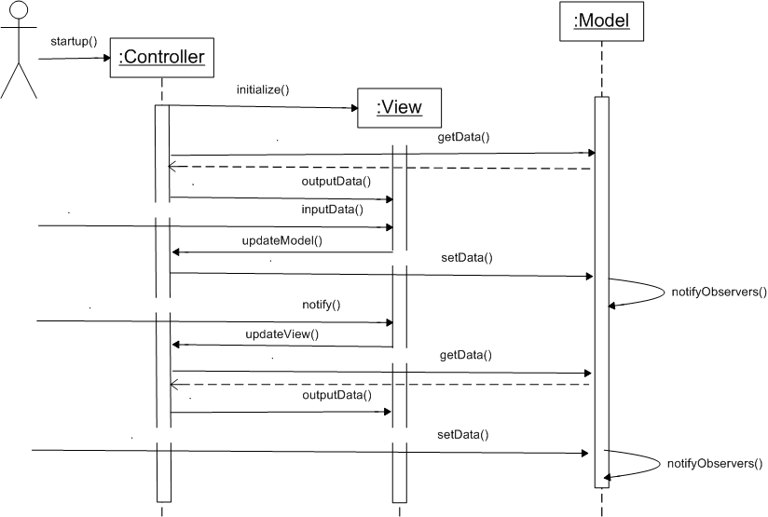
MVC – Component Interaction

Slide 8
MVC – Advantages
Specialisation - separates domain knowledge (Model), logics (Controller) and GUI interface (View)
Customisation - allows for multiple views of the same data
Universality – multiple platforms at the desktop, on the Web and in mobile devices
Quality - easy to add new views (extending), easy to modify (upgrading), control (testing) and monitor (maintaining)

Slide 9
Example: Soccer League Web Application
To develop a Web application, which allows registration and reviewing of the matches in the football league
  Registering leagues
  Registering divisions
  Registering players
  Generating reports
  …

Slide 10
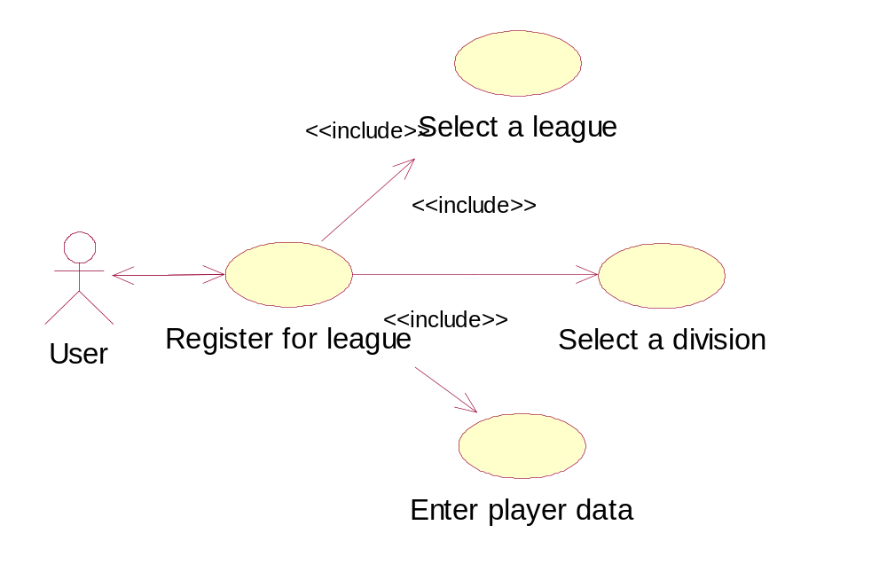
Use Case Scenario for Registering of a Player in a League

Slide 11
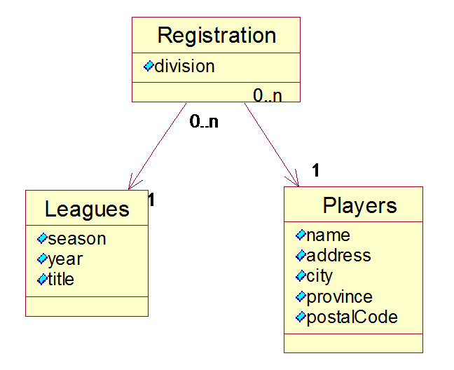
Class diagram of the persistent data needed
3 entity classes
  Leagues
  Players
  Registration
Implemented
as 3 separate
text files

Slide 12
Persistent Data in leagues.txt file
Spring|2001|Soccer League (Spring '01)
Summer|2001|Summer Soccer Fest 2001
Fall |2001|Fall Soccer League (2001)
Spring|2002|Soccer League (Spring '02)
Summer|2002|The Summer of Soccer Love 2002
Fall |2002|Fall Soccer League (2002)

Slide 13
Straightforward solution using servlets (no MVC)
form.html
    input parameters
    invoke servlet
RegistrationServlet.java
  doPost() method
    handles the parameters send from the form
    performs server-side data validation
    error processing
    response generation
  init() method – initializes the data source for handling the persistent data using populateLeagueSet() method
  getLeague() method – gets data from the data source

Slide 14
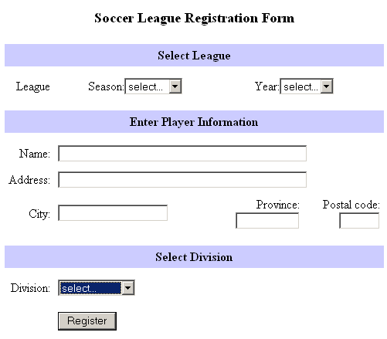
The static Web page form.html

Slide 15
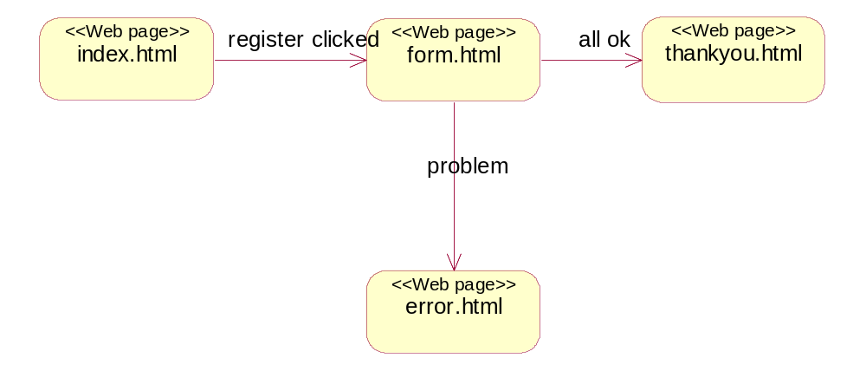
Web site page flow (statechart)

Slide 16
The Servlet RegistrationServlet
232 lines of code
  doPost()
    Mixing information presentation and business logic during request processing
    Low cohesion – too many things to do
Each servlet has its own data sources
Each servlet has its own session for connecting to the data source

Slide 17
MVC1 solution using servlets
Model – based on League and Player objects for persistent data storage, LeagueService and PlayerService objects for data access
  Performs data generation and information retrieval
View – includes dynamic html pages, generated by two of the methods of the servlet - generateThankYouResponse() and generateErrorResponse()
    Performs information presentation only
Controller – processRequest() method
  Navigation control through the available views
  Data access control through the model services

Slide 18
The Model
public class Player {
// Data fileds
String name = "";
String address = "";
String city = "";
String province = "";
String postalCode = "";
// Constructor
Player(String name, String address, String city,
String province, String postalCode) {
this.name = name;
this.address = address;
this.city = city;
this.province = province;
this.postalCode = postalCode;
}
// Accessors
public String getName() {
return name;
}
public void setName(String value) {
name = value;
}
}

Slide 19
The Controller
processRequest() {
/* validate the input */
...
/* delegate the data handling to LeagueService */
...
regService.getLeague(year, season);
regService.getPlayer(name);
regService.register(league, player, division);
...
/* navigate to the HTML response generator view */
...
generateThankYouResponse(request, response);
...
generateErrorResponse(request, response);
...
}

Slide 20
Data exchange between MVC components
Exchange of information through
beans in request scope
In Controller method processRequest
request.setAttribute("league", league);
request.setAttribute("player", player);
In View method generateThankYouResponse
League league= (League)request.getAttribute("league");
Player player= (Player)request.getAttribute("player");
In Model method register
playerWriter.print(player.name);

Slide 21
Comparison: RegistrationServlet
Much shorter - 195 lines of code, but including the two dynamically generated views (43 lines for error view and 34 lines for thankyou view)
  Therefore only 118 lines vs 232 for the non-MVC servlet
Much better structure
  Separation of concerns - Session isolation, Separation of Business logic and Domain logic, Data sources isolation
  Better code readability
  Better maintainability of the whole application
In reality
  Don’t code from scratch – use examples as a template
  Don’t code manually - use framework as a tool (e.g., PHP Joomla, Java Spring)

Slide 22
3 Extended MVC in Java EE
Limitations of the classical Java SE MVC model
  The persistent data is handled by the model components, which live within the same JVM; this limits its use to in-memory data only, while most of the persistent data is stored in DB or files
  The data processing is performed by the controller; this limits its use to local operations only, while the remote operations and services are excluded
  The data is passed between the components via parameters, which is not very convenient when referencing is not allowed and copying is too costly
  The user session is automatically extended to the data access, which leads to too many backend connections

Slide 23
Java EE components for MVC
Models - Data Storing and Retrieval on the backend
  Different data sources – data files, XML DOMs, EJB entity beans, SQL Databases, LDAP repositories, etc.
  Limited data operations (i.e., validation, encryption)
  Limited control logics (i.e., file i/o, XML parsing, traversing and querying, database querying)
Views - Information Presentation on the Web frontend
  Different user interface - HTMLs, servlets, JSPs, JSFs
  Limited data operations (i.e., conversion, formatting)
  Limited control logics (i.e., parameter handling)
Controllers - Navigation and Events Synchronization
  Different components – servlets, beans, EJB beans
  Control logic (sessions, pooling, dispatching, delegation)
  Business logic (operations, events, transactions)

Slide 24
Additional Design Patterns complementing MVC in Java EE
Factory: Controls class instantiation, thus providing support for isolation (i.e., session control, pooling)
Data Access Object (DAO): Allows accessing of both local and external data outside of the current container (i.e., files, databases, directories, legacy systems)
Business Delegate: Allows invocation of both local and remote operations, executed outside of the current container (i.e., EJB, CORBA, Web Services)
Session Facade: Separates the session for accessing the data from the sessions for processing the requests, which allows sharing database sessions amongst several Web sessions

Slide 25
DAO and Factory patterns
ObjectID (factory class) – a class which provides the references to the individual data objects extracted from the data source; uses a generator for the IDs of the data beans
Connection (factory class)
PlayerDAO (data access class ) – expose an interface of source neutral methods for data processing; use a pool of connections
LeagueDAO (data access class) – expose an interface of data source specific methods for data processing; used by the services when need data

Slide 26
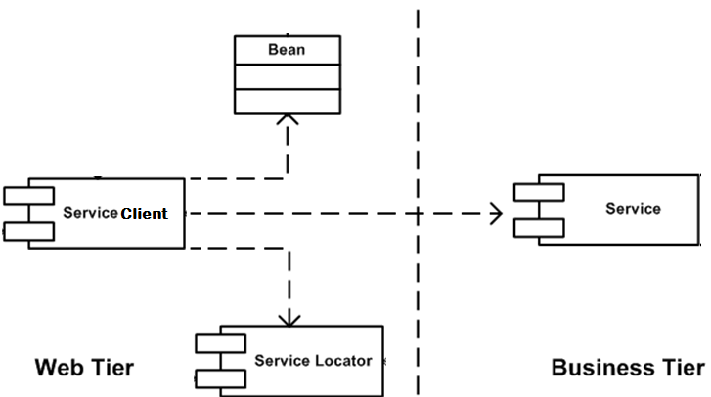
Business Delegate Pattern for remote data processing

Slide 27
Business Delegate Pattern (cont.)
  Decoupling: In the Business Delegate Pattern the Web tier is decoupled from the Business Logic – the UI (in this case the view) and the event processor (in this case the controller) are in the Web tier, while the actual processing occurs in the Business tier
  Locating: The Controller uses additional component (Service Locator) to locate the business service needed. Typically it calls the standard JNDI API to find the reference to the Business Delegate
  Bridging: The Business Delegate passes the request for processing of the Web data outside the Web container, typically in the EJB Container, but can be elsewhere

Slide 28
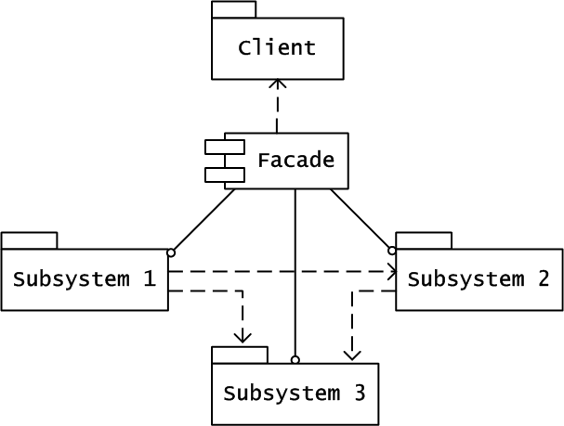
Facade Pattern for separating the interface from the implementation
Client
Facade

Slide 29
Facade Pattern (cont.)
Façade object
  holds references to the subsystem objects
  dispatches the client requests to appropriate subsystem objects via their references
Subsystem objects
  implement subsystem functionality and handle work assigned to them by the façade object
  have no references to the façade object
Façade and Delegate patterns are often combined – in our example they are implemented by LeagueService and PlayerService classes

Slide 30
Example: The league with external data storage, remote access and additional services
<<bean>>
Player
<<servlet>>
Player
Registration
<<service>>
RegisterPlayer
<<data access>>
PlayerDAO
<<data>>
Players
<<factory>>
Connection
<<factory>>
ObjectID
<<servlet>>
League
Admin
<<service>>
AdminLeague
<<data access>>
LeagueDAO
<<data>>
Leagues
<<bean>>
League

Slide 31
4 Java EE MVC Architectures
Model 1 Architecture (MVC 1)
  JSP components process the request and use Java beans, JSTL and custom tags to communicate with business logic
  JSP components prepares the response, retrieving the data from the beans
Model 2 Architecture (MVC 2)
  Servlets process the request, interact with the business logic and collect the business data to be displayed
  JSPs render the data to be displayed
Model 3 Architecture (MVC 3)
  Servlets process the request, interact with the business logic and collect the business data to be displayed
  JSFs render the pages to input and output data

Slide 32
MVC Operations in the Web Tier
Browser sends a request for processing data
The Controller servlet processes the request extracting the parameters from it
The Controller servlet passes the data to the model for updating
When the servlets receives request for extracting data it collects it from the model via Service-to-worker pattern
Then it selects a view to render the data and dispatches it to it
The view renders the data, possibly using custom tags

Slide 33
MVC Operations which require middleware
Delegating the execution to service methods (delegate pattern)
Mapping references to remote objects via JNDI (facade pattern)
Pooling of the connections and services (factory pattern)

Slide 34
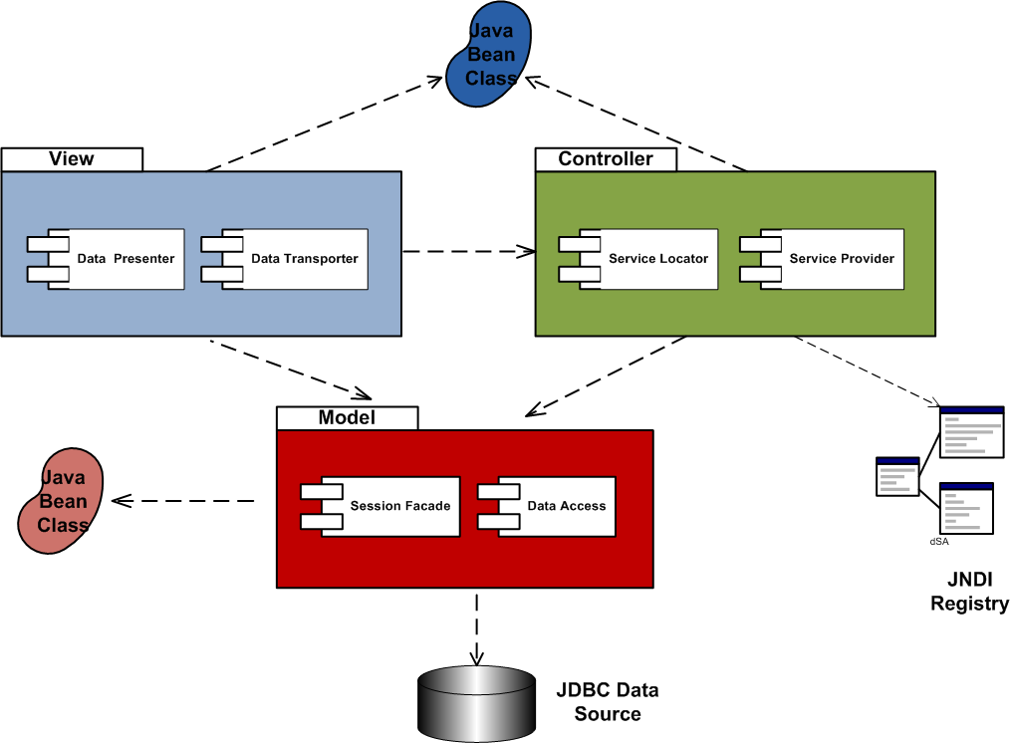
Java EE MVC Components

Slide 35
Industrial MVC Frameworks for Java EE
Generic functionality which can be extended
  Some generic capability to process the event flow
  All requests are processed the same way by the controller
  The controller can be expressed in a declarative way rather than in cod
    Examples: Apache Struts (the controller behaviour is specified using XML), Sun JSF (the views are assembled out of ready components glued using XML), Spring

